Slide 1




French Riviera, Spain & Ibiza Overnight
Barcelona • Cannes • Provence (Toulon) • Valencia • Ibiza • Barcelona
1 night in Barcelona + 7 nights sailing
Departing 15 May 2027
All flights included
Lead in package price from
Sea Terrace cabin from £1619pp
£1399pp
£30pp in resort fees payable locally. Subject to change. View terms here: sellvv.co.uk/terms
Insert your
logo here

Slide 2
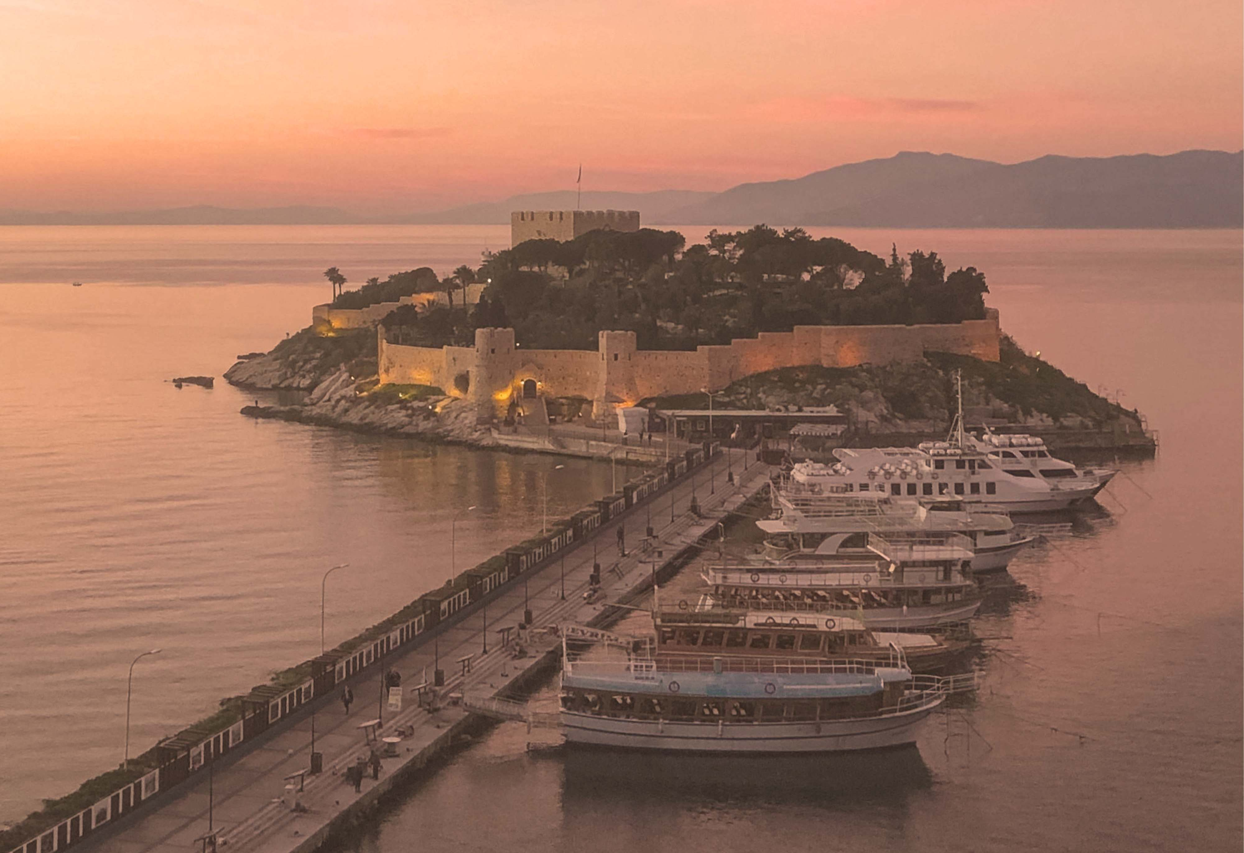
Greek Isles, Turkey & Mykonos Overnight
Athens (Piraeus) • Santorini • Chania (Souda Bay) • Ephesus (Kuşadasi) • Mykonos • Athens (Piraeus)
1 night in Athens + 7 nights sailing
Departing 15 May 2027
All flights included
Lead in package price from
Sea Terrace cabin from £2049pp
£1799pp
£30pp in resort fees payable locally. Subject to change. View terms here: sellvv.co.uk/terms
Insert your
logo here

Slide 3

Red Hot Sailing Club Voyage from Athens
Athens (Piraeus) • Santorini • Chania (Souda Bay) • Ephesus (Kuşadasi) • Mykonos • Athens (Piraeus)
1 night in Athens + 7 nights sailing
Departing 3 July 2027
All flights included
Lead in package price from
Sea Terrace cabin from £1999pp
£1749pp
£30pp in resort fees payable locally. Subject to change. View terms here: sellvv.co.uk/terms
Insert your
logo here

Slide 4
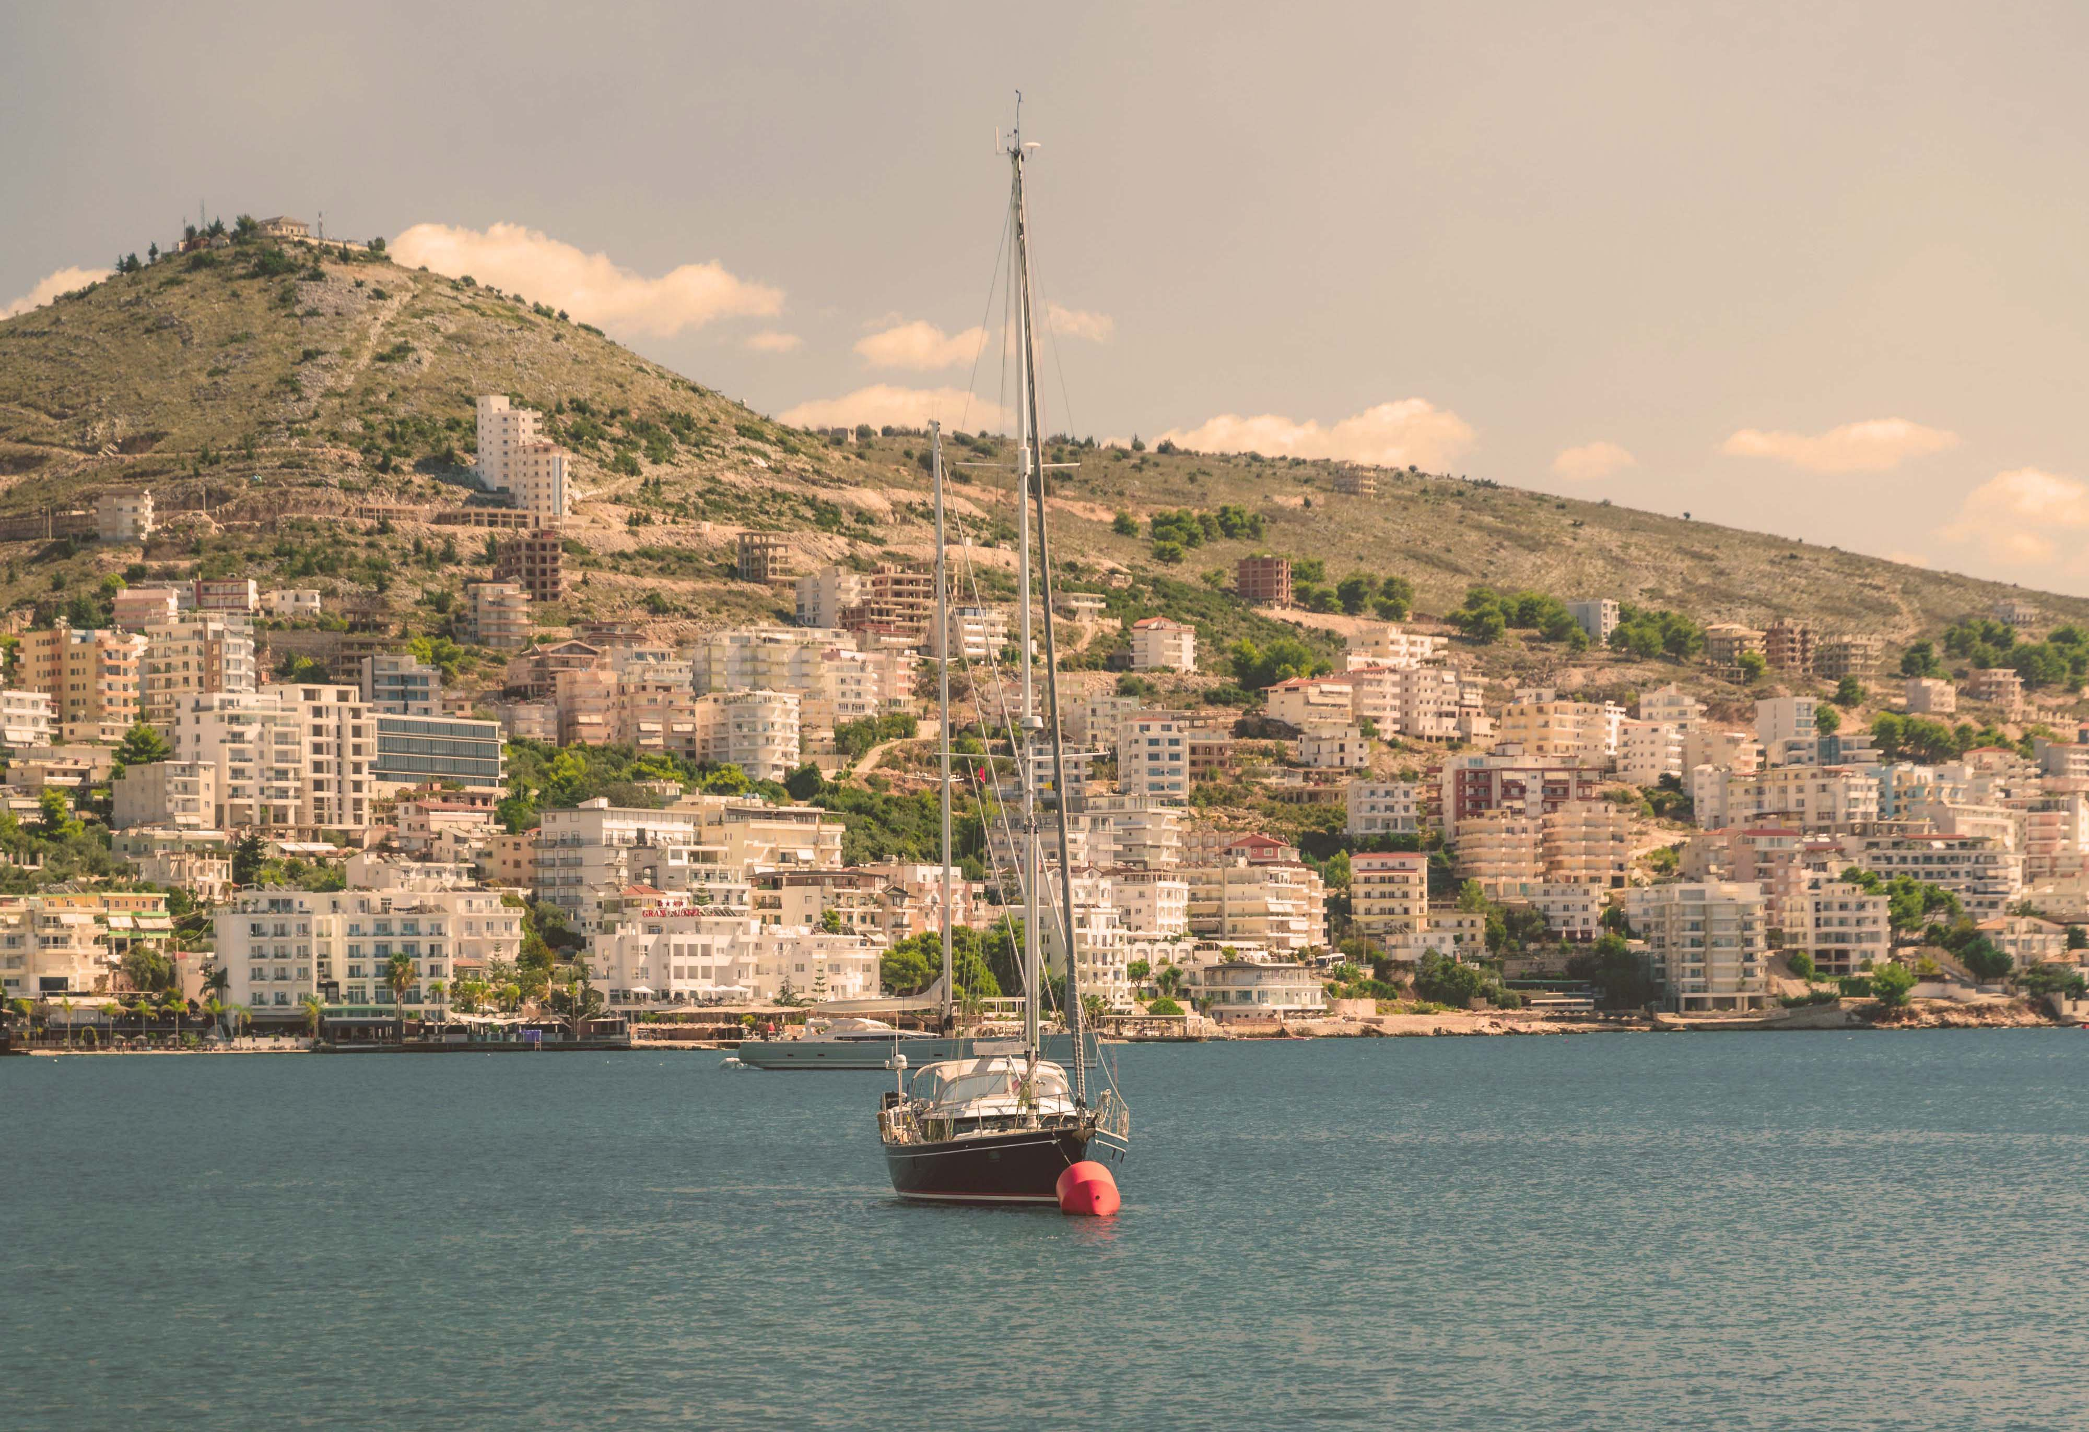
The Adriatic, Albania & Greece
Athens (Piraeus) • Dubrovnik • Kotor • Sarandë • Mykonos • Athens (Piraeus)
1 night in Athens + 7 nights sailing
Departing 19 June 2027
All flights included
Lead in package price from
Sea Terrace cabin from £2249pp
£1949pp
£30pp in resort fees payable locally. Subject to change. View terms here: sellvv.co.uk/terms
Insert your
logo here

Slide 5

Mediterranean: Rome to Athens
Rome (Civitavecchia) • Florence/Pisa (Livorno) • Amalfi Coast (Salerno) • Catania •
Chania (Souda Bay) • Santorini • Mykonos • Athens (Piraeus)
1 night in Rome + 10 nights sailing
Departing 30 August 2026
All flights included
Lead in package price from
Sea Terrace cabin from £2139pp
Offer reference: 132464
£1909pp
£30pp in resort fees payable locally. Subject to change. View terms here: sellvv.co.uk/terms
Insert your
logo here

Slide 6

Iceland, Greenland, Canada & NYC
Reykjavik • Ísafjörður • Prince Christian Sound (Cruising) • Qaqortoq •
Nuuk • St. John's • Halifax • New York City
1 night in Keflavik + 13 nights
Departing 5 September 2026
All flights included
Lead in package price from
Sea Terrace cabin from £2404pp
Offer reference: 132459
£2299pp
£30pp in resort fees payable locally. Subject to change. View terms here: sellvv.co.uk/terms
Insert your
logo here

