Slide 1





French Riviera, Italy & Ibiza Overnight
Barcelona • Rome (Civitavecchia) • Tuscany/Cinque Terre (La Spezia) • Cannes • Ibiza • Barcelona
1 night in Barcelona + 7 nights
Departing 20 June 2026
All flights included
SEA TERRACE PACKAGE FROM
Free Balcony Upgrade price
£1549pp
£30pp in resort fees payable locally. Subject to change. View terms here: sellvv.co.uk/terms
Insert your
logo here

Slide 2

Greek Isles & Istanbul Overnight
Athens (Piraeus) • Istanbul • Ephesus (Kuşadasi) • Mykonos •
Chania (Souda Bay) • Rhodes • Santorini • Athens (Piraeus)
1 night in Athens + 11 nights
Departing 23 June 2026
All flights included
SEA TERRACE PACKAGE FROM
Free Balcony Upgrade price
£2099pp
£30pp in resort fees payable locally. Subject to change. View terms here: sellvv.co.uk/terms
Insert your
logo here

Slide 3
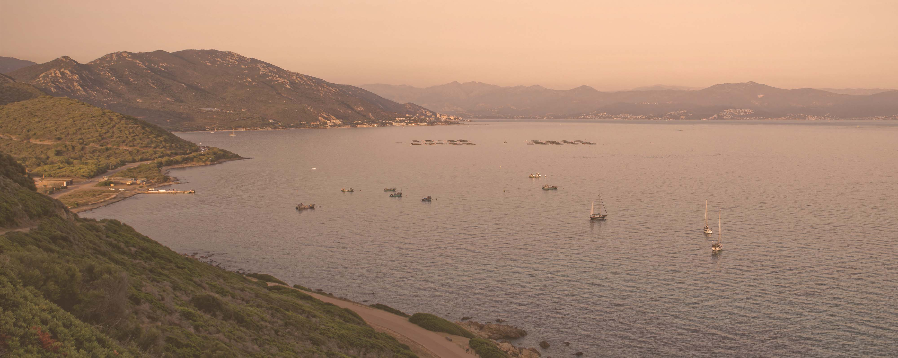
Total Eclipse of the (Med)
Barcelona • Palma de Mallorca • Ibiza • Cannes • Ajaccio • Tuscany/Cinque Terre (La Spezia) •
Amalfi Coast (Salerno) • Catania • Rome (Civitavecchia)
1 night in Barcelona + 12 nights
Departing 9 August 2026
All flights included
SEA TERRACE PACKAGE FROM
Free Balcony Upgrade price
£2599pp
£30pp in resort fees payable locally. Subject to change. View terms here: sellvv.co.uk/terms
Insert your
logo here

Slide 4

French Riviera, Italy & Ibiza Overnight
Barcelona • Rome (Civitavecchia) • Florence/Pisa (Livorno) • Cannes • Ibiza • Barcelona
1 night in Barcelona + 7 nights
Departing 3 July 2026
All flights included
SEA TERRACE PACKAGE FROM
Free Balcony Upgrade price
£1549pp
£30pp in resort fees payable locally. Subject to change. View terms here: sellvv.co.uk/terms
Insert your
logo here

Slide 5
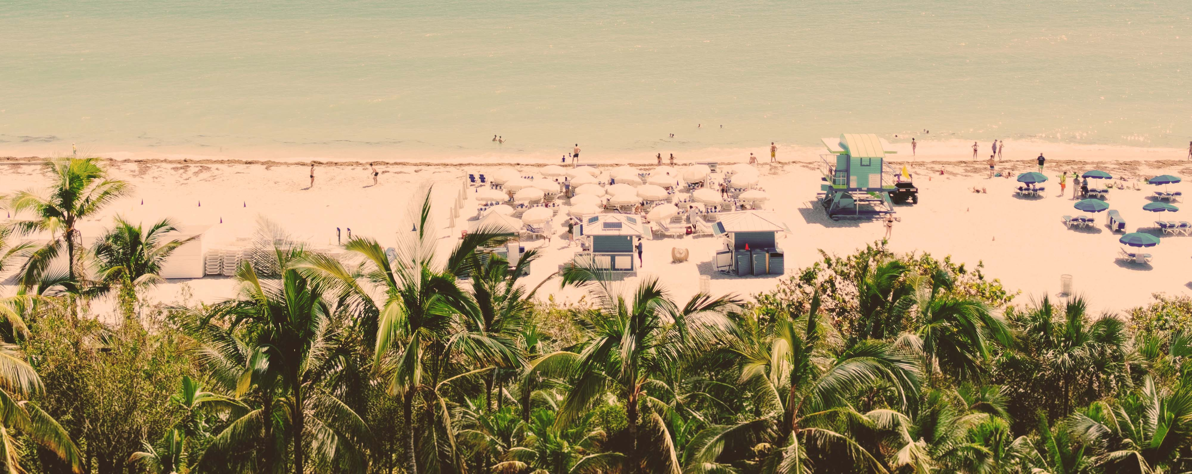
Eastern Caribbean & Bimini Beach Club
Miami • Philipsburg • Tortola • St. Croix • San Juan • Puerto Plata • The Beach Club at Bimini • Miami
1 night in Miami + 10 nights
Departing 29 November 2026
All flights included
SEA TERRACE PACKAGE FROM
Free Balcony Upgrade price
£2399pp
£60pp in resort fees payable locally. Subject to change. View terms here: sellvv.co.uk/terms
Insert your
logo here

Slide 6
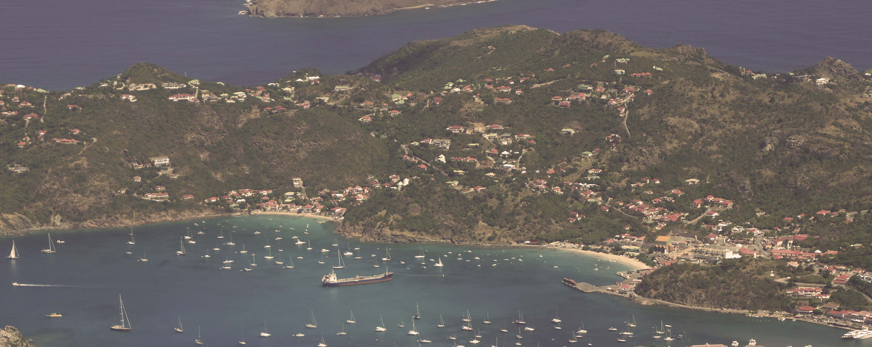
Eastern Caribbean & Bimini New Year's
Miami • Philipsburg • Basseterre • Tortola • St. John's • The Beach Club at Bimini • Miami
1 night in Miami + 10 nights
Departing 27 December 2026
All flights included
SEA TERRACE PACKAGE FROM
Free Balcony Upgrade price
£3399pp
£60pp in resort fees payable locally. Subject to change. View terms here: sellvv.co.uk/terms
Insert your
logo here

