Slide 1





Panama Canal: Miami to Los Angeles
Miami • Cartagena • Colón • Panama Canal (Cruising) • Puntarenas •
Puerto Quetzal • Cabo San Lucas • Los Angeles
1 night in Miami + 16 nights sailing
Departing 25 March 2027
All flights included
Lead in package price from
Sea Terrace cabin from £3679pp
Offer reference 132055
£3019pp
£60pp in resort fees payable locally. Subject to change. View terms here: sellvv.co.uk/terms
Insert your
logo here

Slide 2
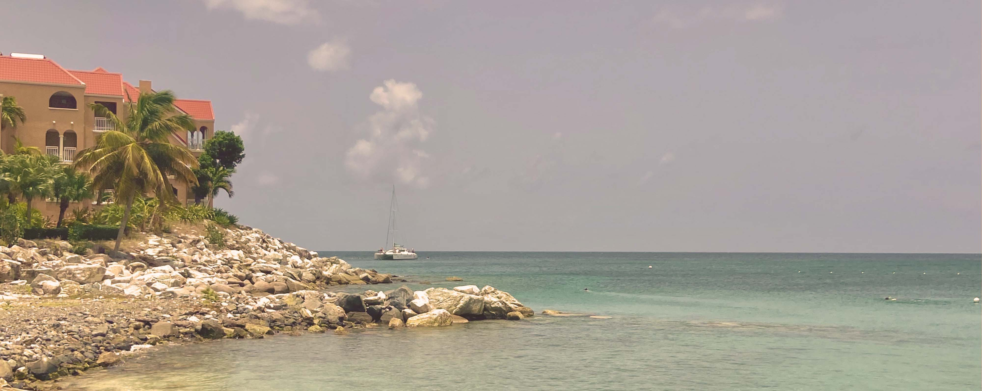
Eastern Caribbean & Bimini Beach Club
Miami • Philipsburg • Tortola • St. Croix • San Juan • Puerto Plata • The Beach Club at Bimini • Miami
1 night in Miami + 10 nights sailing
Departing 10 January 2027
All flights included
Lead in package price from
Sea Terrace cabin from £2509pp
Offer reference 132057
£2159pp
£60pp in resort fees payable locally. Subject to change. View terms here: sellvv.co.uk/terms
Insert your
logo here

Slide 3

New England & Canada Cruise
New York City • Boston • Portland • Saint John • Halifax • New York City
1 night in New York + 8 nights sailing
Departing 18 September 2026
All flights included
Sea Terrace package price from
Offer reference 132062
£2439pp
£60pp in resort fees payable locally. Subject to change. View terms here: sellvv.co.uk/terms
Insert your
logo here

Slide 4
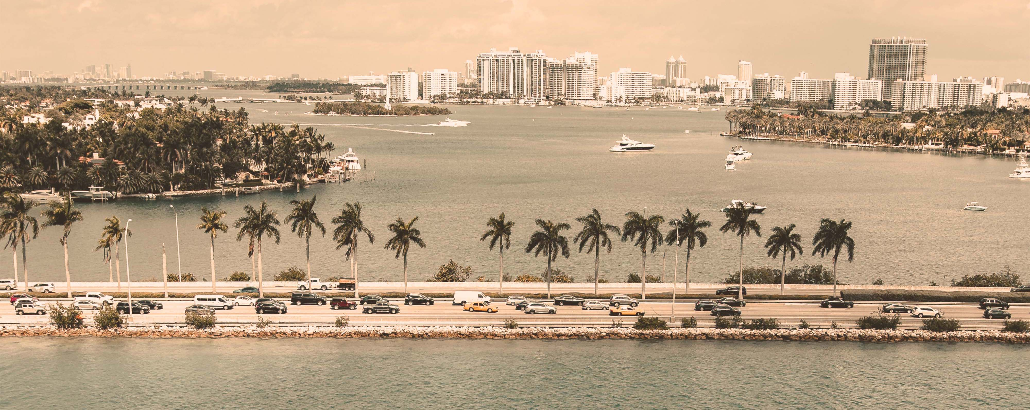
Miami to Morocco & Spain Transatlantic
Miami • Las Palmas de Gran Canaria • Casablanca • Valencia • Barcelona
1 night in Miami + 14 nights sailing
Departing 23 April 2027
All flights included
Lead in package price from
Sea Terrace cabin from £2299pp
£2049pp
£60pp in resort fees payable locally. Subject to change. View terms here: sellvv.co.uk/terms
Insert your
logo here

Slide 5

Italy, French Riviera & Spain
Barcelona • Tuscany/Cinque Terre (La Spezia) • Rome (Civitavecchia) • Ajaccio •
Provence (Marseille) • Palma de Mallorca • Barcelona
1 night in Barcelona + 7 nights sailing
Departing 3 July 2027
All flights included
Lead in package price from
Sea Terrace cabin from £1949pp
£1749pp
£30pp in resort fees payable locally. Subject to change. View terms here: sellvv.co.uk/terms
Insert your
logo here

Slide 6

Western Med: Athens to Barcelona
Athens (Piraeus) • Mykonos • Kotor • Catania • Amalfi Coast (Salerno) •
Tuscany/Cinque Terre (La Spezia) • Cannes • Provence (Marseille) • Barcelona
1 night in Athens + 11 nights sailing
Departing 15 June 2027
All flights included
Lead in package price from
Sea Terrace cabin from £2699pp
£2349pp
£30pp in resort fees payable locally. Subject to change. View terms here: sellvv.co.uk/terms
Insert your
logo here

