Slide 1
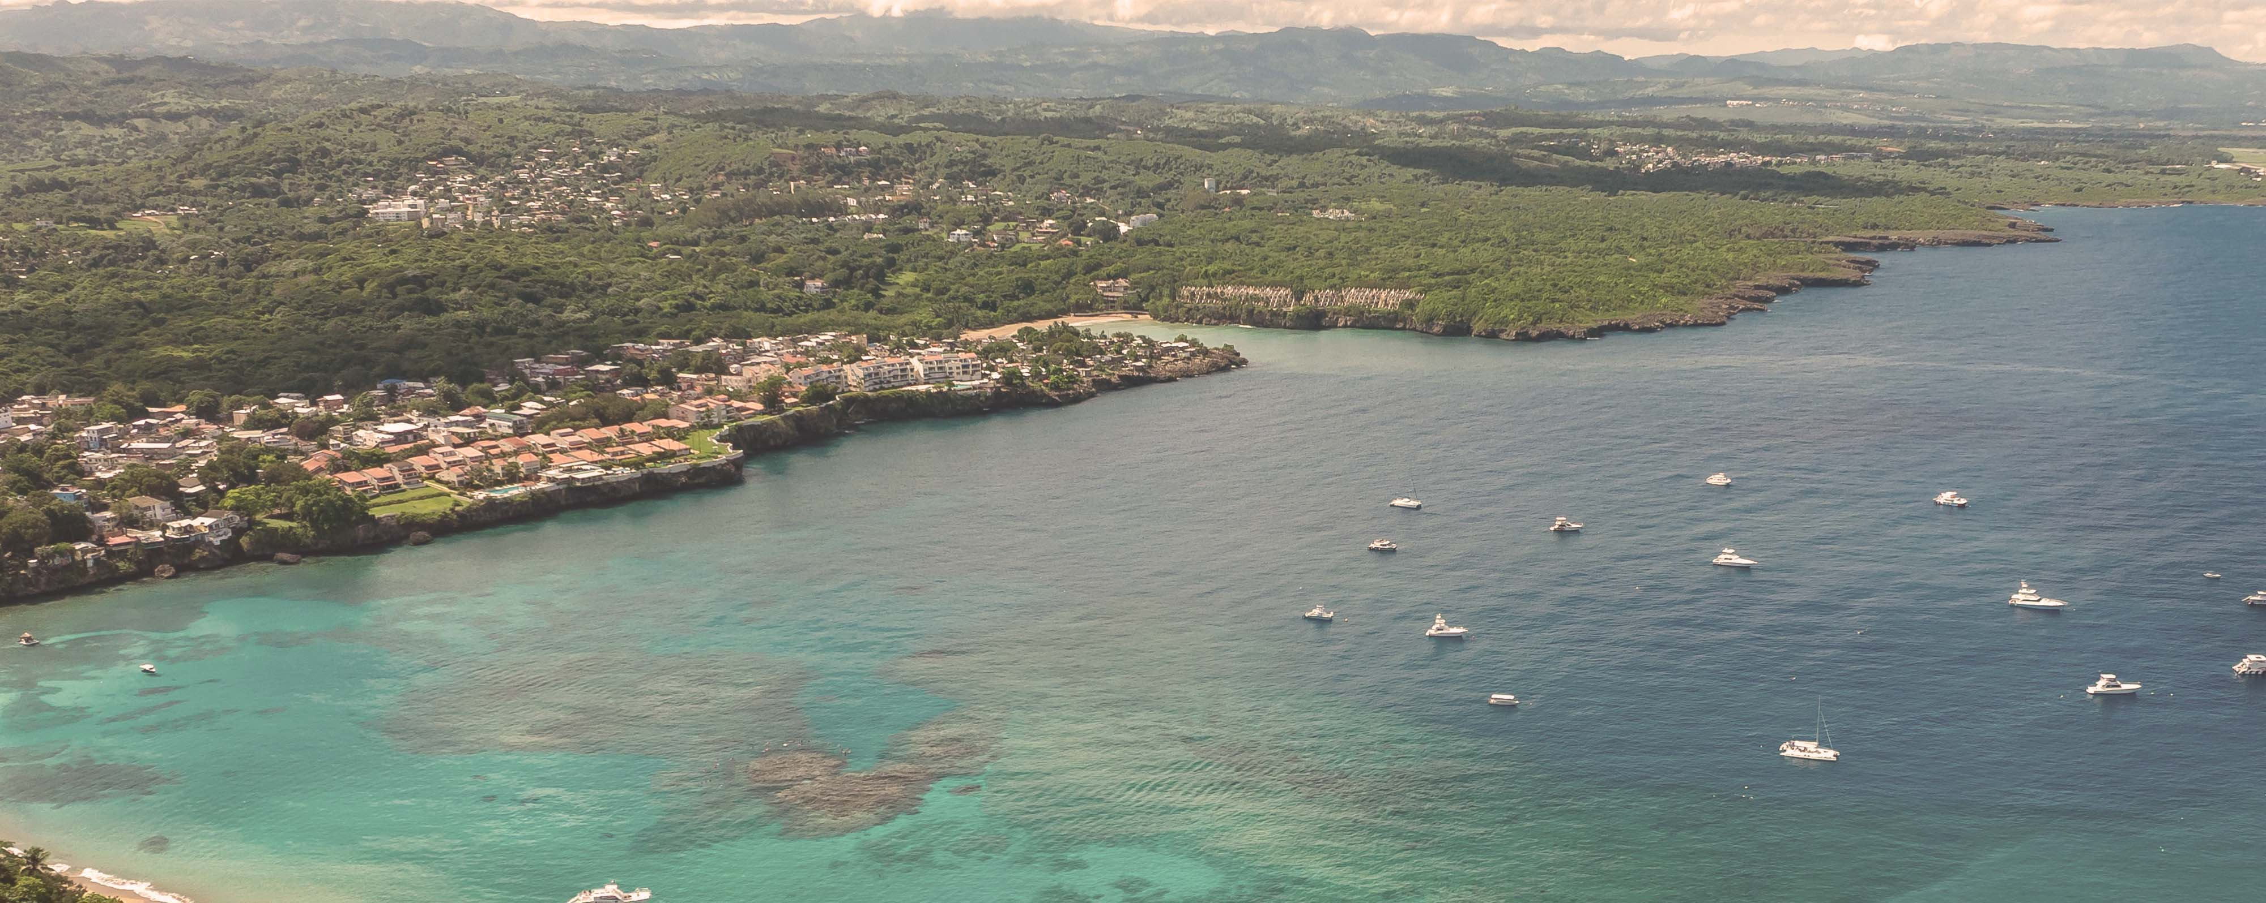




Eastern Caribbean & Bimini Beach Club
Miami • Philipsburg • Tortola • St. Croix • San Juan • Puerto Plata • The Beach Club at Bimini • Miami
1 night in Miami + 10 nights sailing
Departing 10 January 2027
All flights included
Lead in package price from
Sea Terrace cabin from £2099pp
£1899pp
£60pp in resort fees payable locally. Subject to change. View terms here: sellvv.co.uk/terms
Insert your
logo here

Slide 2
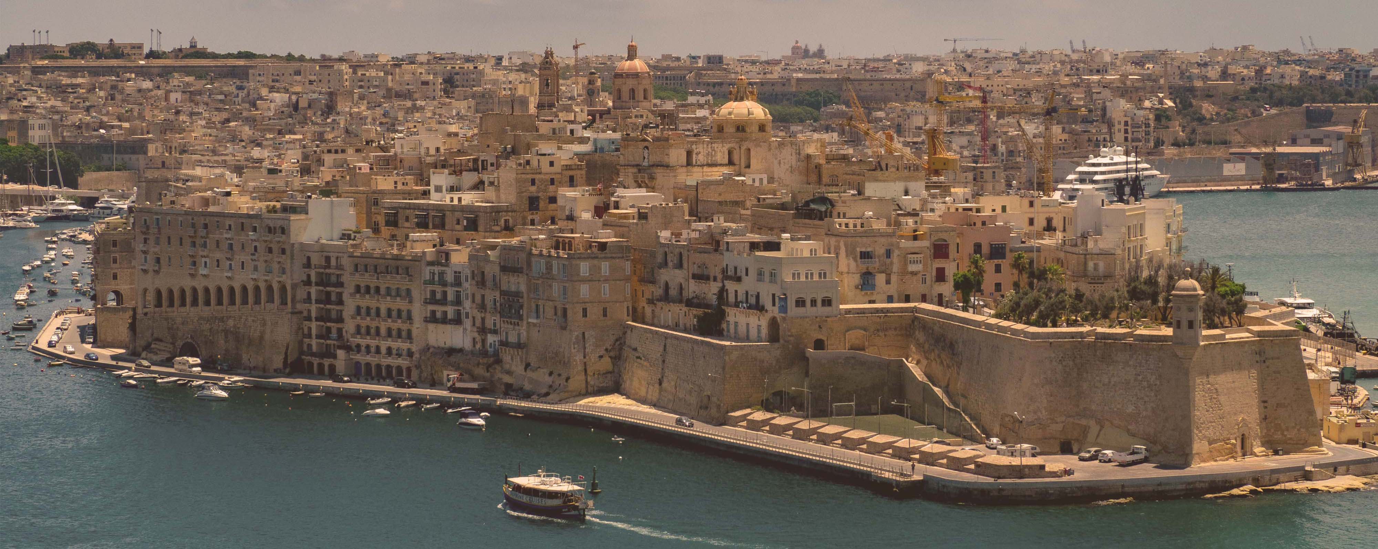
Italy, French Riviera, Spain & Malta
Barcelona • Cannes • Ajaccio • Rome (Civitavecchia) • Amalfi Coast (Salerno) •
Catania • Valletta • Palma de Mallorca • Barcelona
1 night in Barcelona + 10 nights sailing
Departing 17 July 2027
All flights included
Lead in package price from
Sea Terrace cabin from £2749pp
£2249pp
£30pp in resort fees payable locally. Subject to change. View terms here: sellvv.co.uk/terms
Insert your
logo here

Slide 3
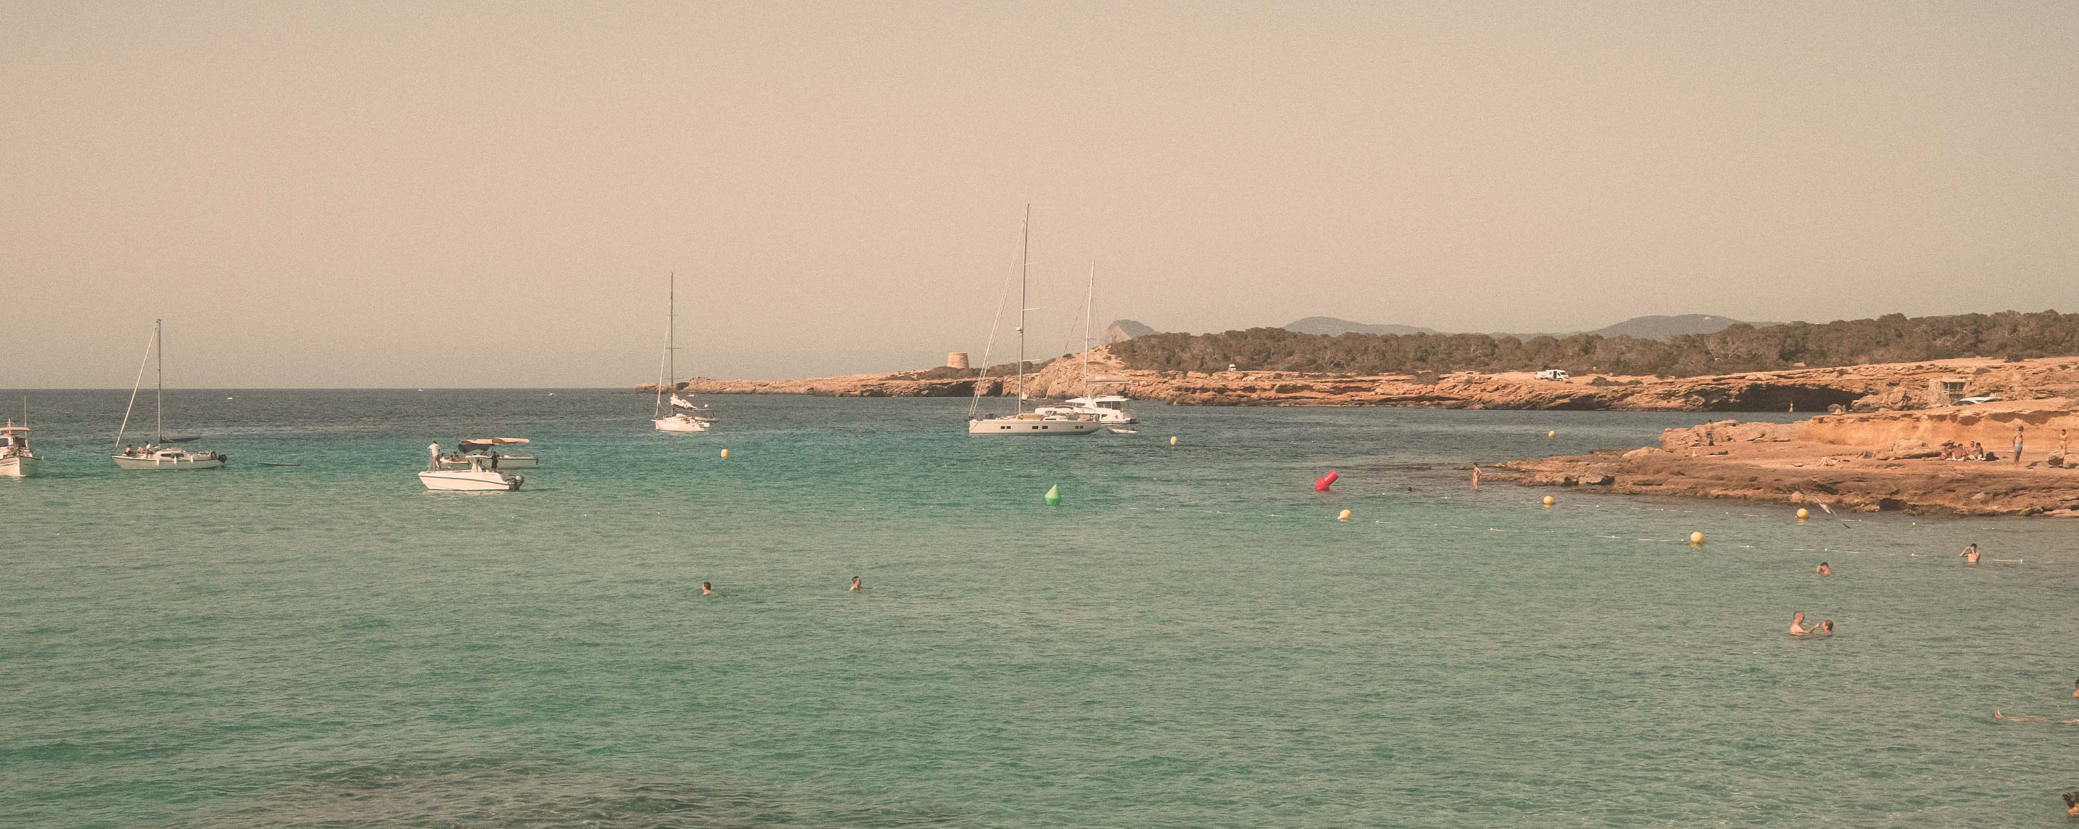
French Riviera, Spain & Ibiza Overnight
Barcelona • Cannes • Provence (Toulon) • Valencia • Ibiza • Barcelona
1 night in Barcelona + 7 nights sailing
Departing 15 May 2027
All flights included
Sea Terrace package price from
Insider cabin SOLD OUT
£1949pp
£30pp in resort fees payable locally. Subject to change. View terms here: sellvv.co.uk/terms
Insert your
logo here

Slide 4

Solar Eclipse: Spain, Portugal, Morocco
Barcelona • Palma de Mallorca • Málaga • Seville (Cádiz) • Funchal • Tangier • Valencia • Barcelona
1 night in Barcelona + 11 nights sailing
Departing 27 July 2027
All flights included
Sea Terrace package price from
Insider cabin SOLD OUT
£2749pp
£30pp in resort fees payable locally. Subject to change. View terms here: sellvv.co.uk/terms
Insert your
logo here

Slide 5

Eastern Caribbean & Bimini Beach Club
Miami • Philipsburg • Tortola • Basseterre • St. John's • The Beach Club at Bimini • Miami
1 night in Miami + 10 nights sailing
Departing 24 January 2027
All flights included
Lead in package price from
Sea Terrace cabin from £2229pp
£1949pp
£60pp in resort fees payable locally. Subject to change. View terms here: sellvv.co.uk/terms
Insert your
logo here

Slide 6

Norwegian Fjords
Amsterdam • Molde • Nordfjordeid • Flåm • Bergen • Amsterdam
1 night in Amsterdam + 7 nights sailing
Departing 30 July 2028
All flights included
Lead in package price from
Sea Terrace cabin from £2162pp
£1899pp
£30pp in resort fees payable locally. Subject to change. View terms here: sellvv.co.uk/terms
Insert your
logo here

